Slide 1


BLUETOOTH BASED
SMART SENSOR NETWORK .
Students name | Roll No .
Priyush Khobragade | 52
Ayushi Maske | 15
Kaustubh Dhakate | 10
Akshay Lohar | 54
GUIDE NAME :- Dr. ANAND KUMAR SOURABH

Slide 2
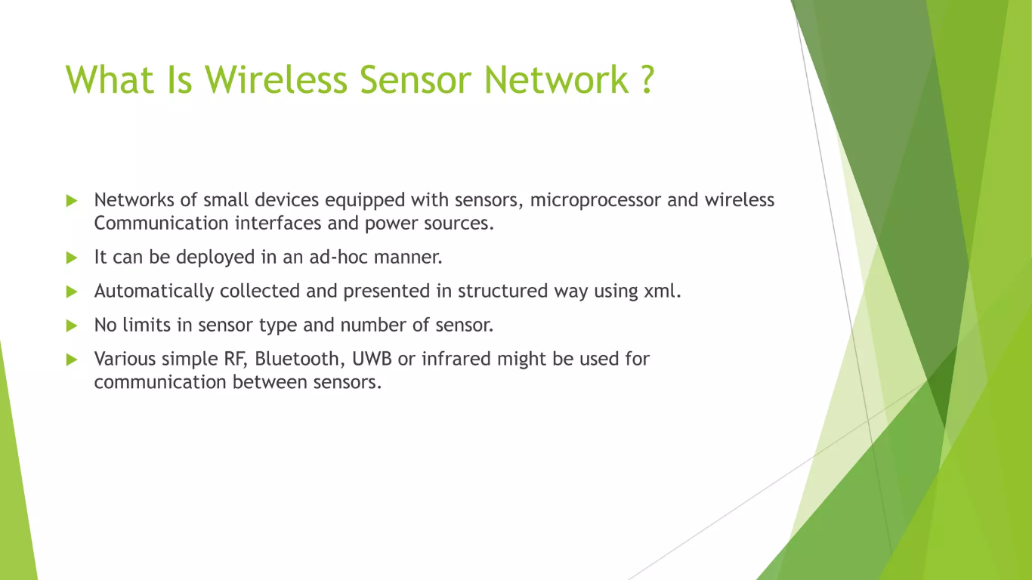
INTRODUCTION

Slide 3
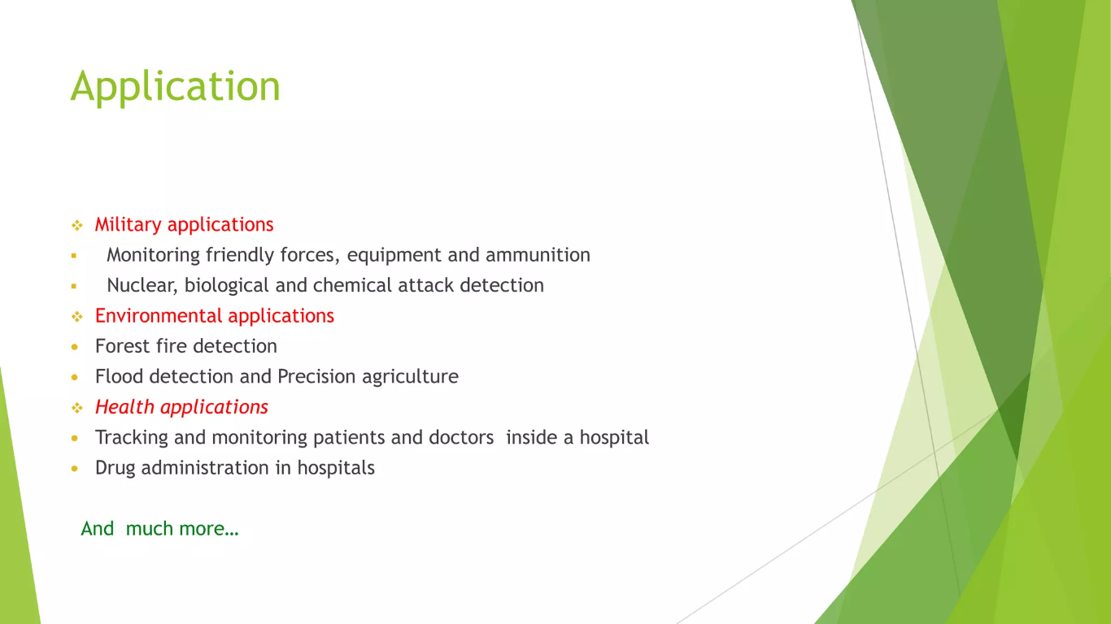

Slide 4
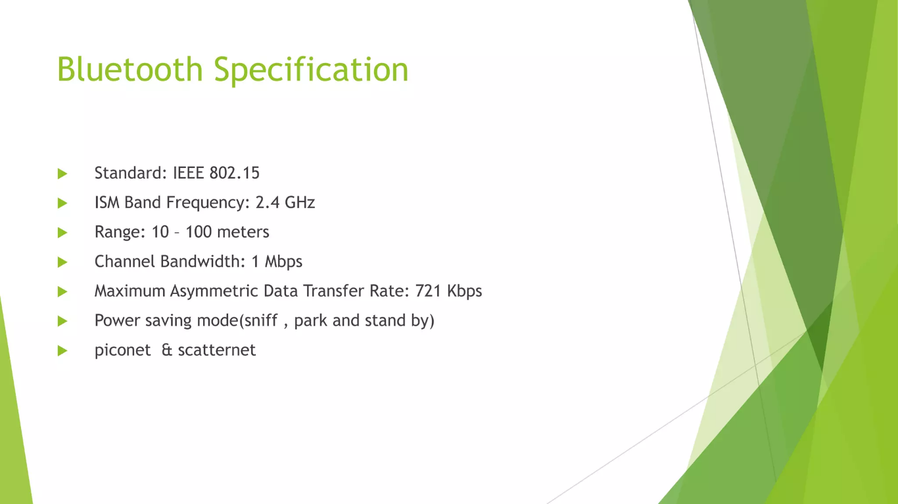

Slide 5
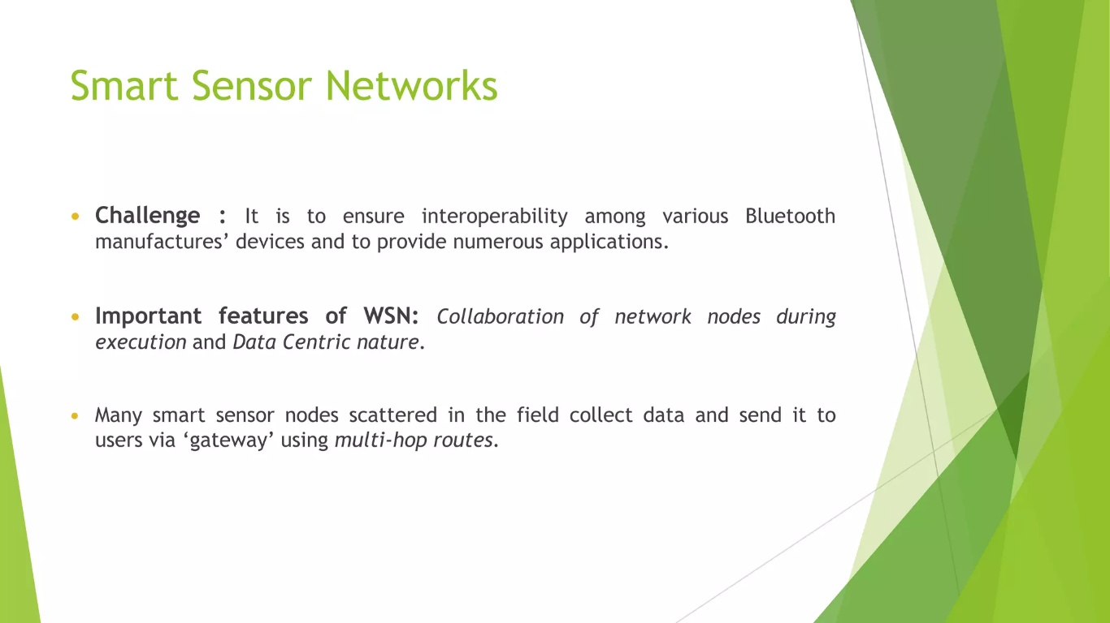

Slide 6
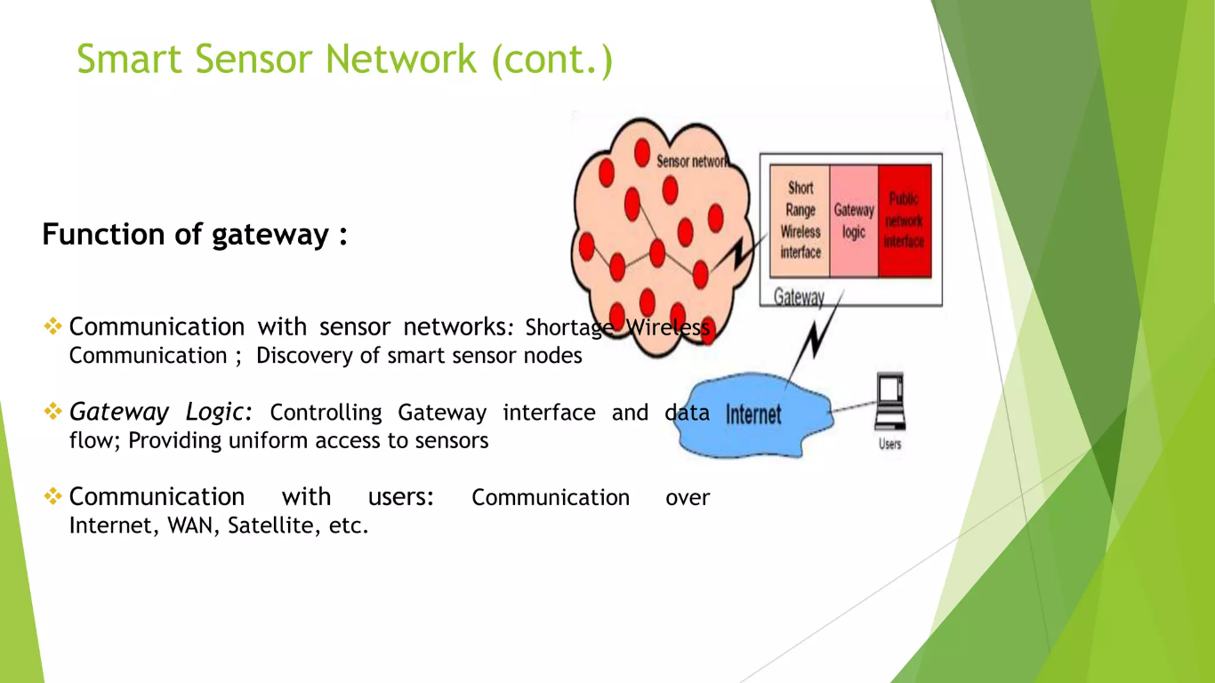

Slide 7
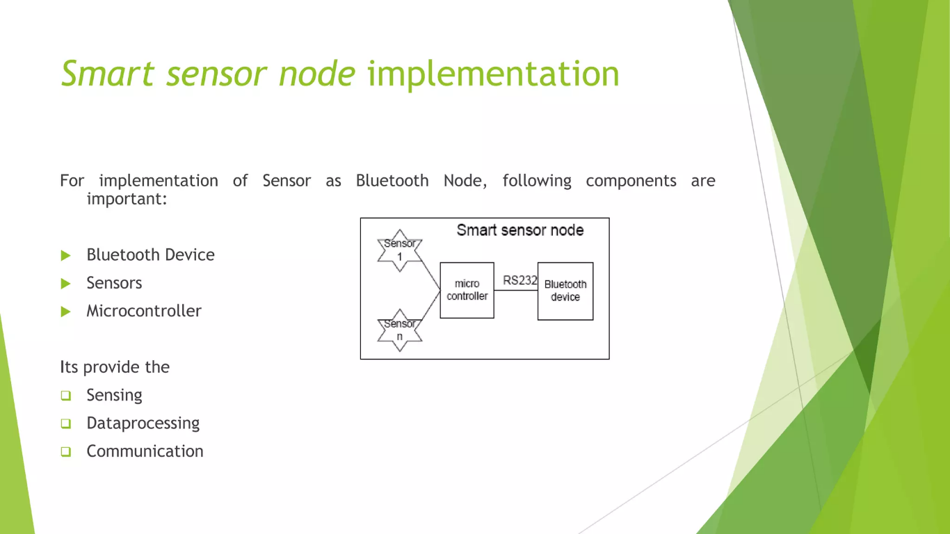

Slide 8
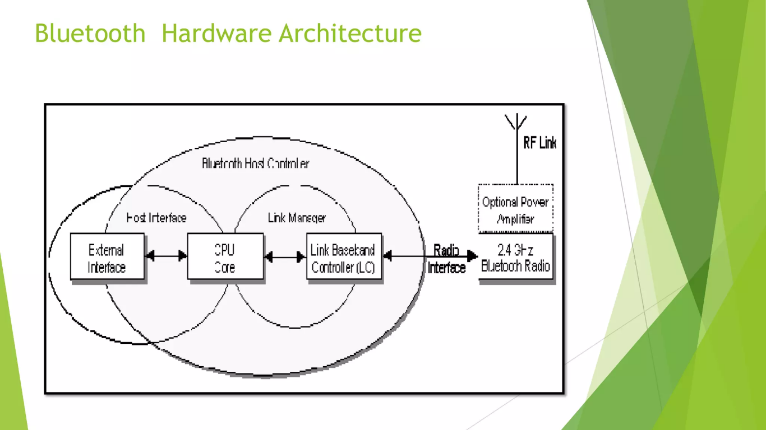
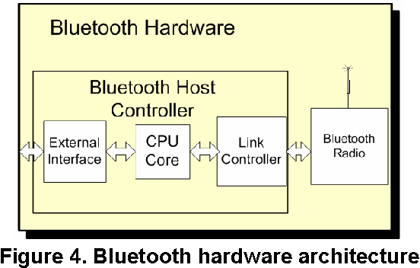

Slide 9
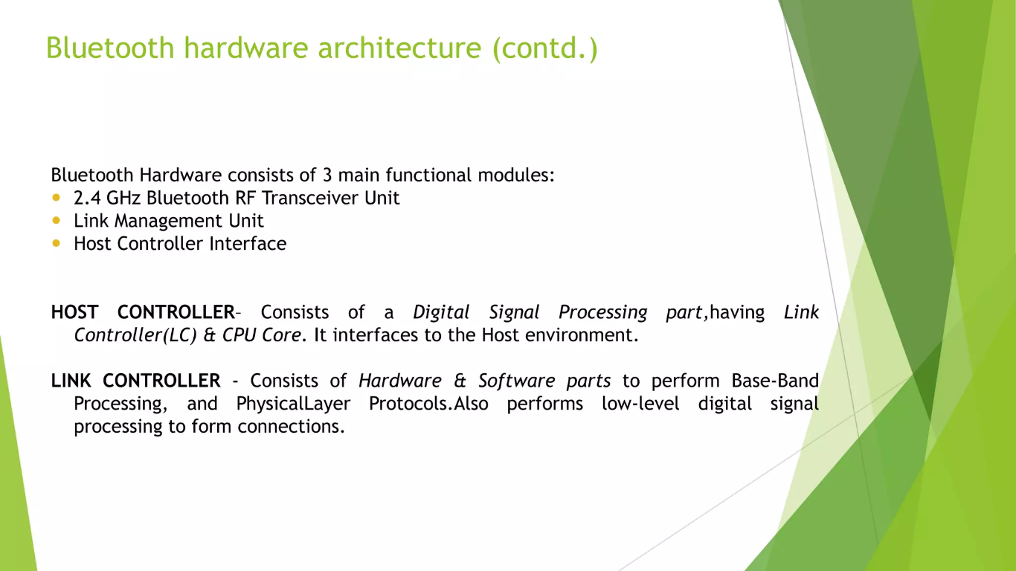

Slide 10
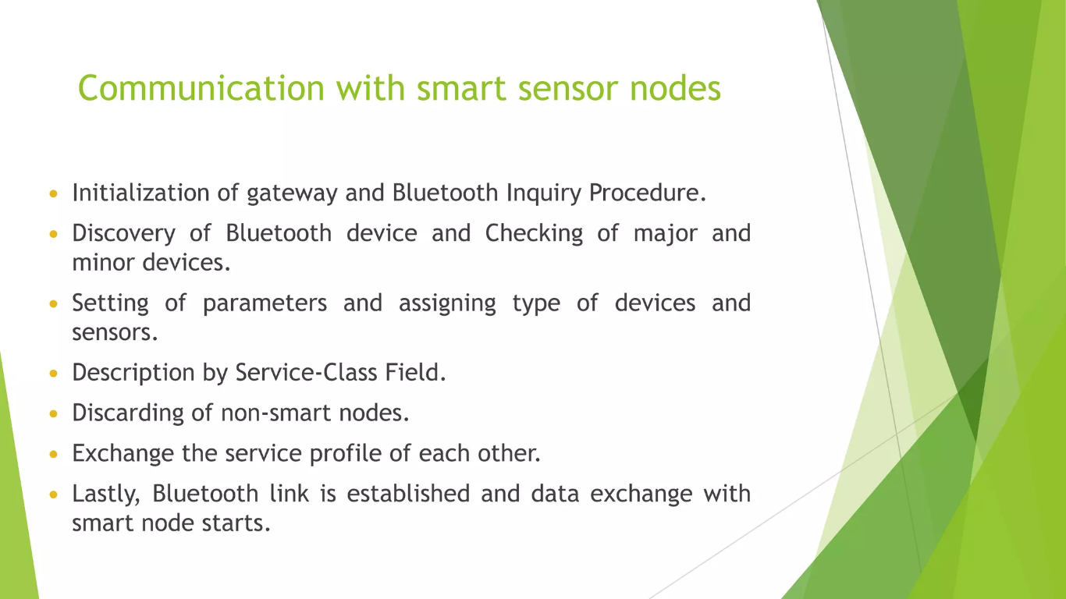

Slide 11
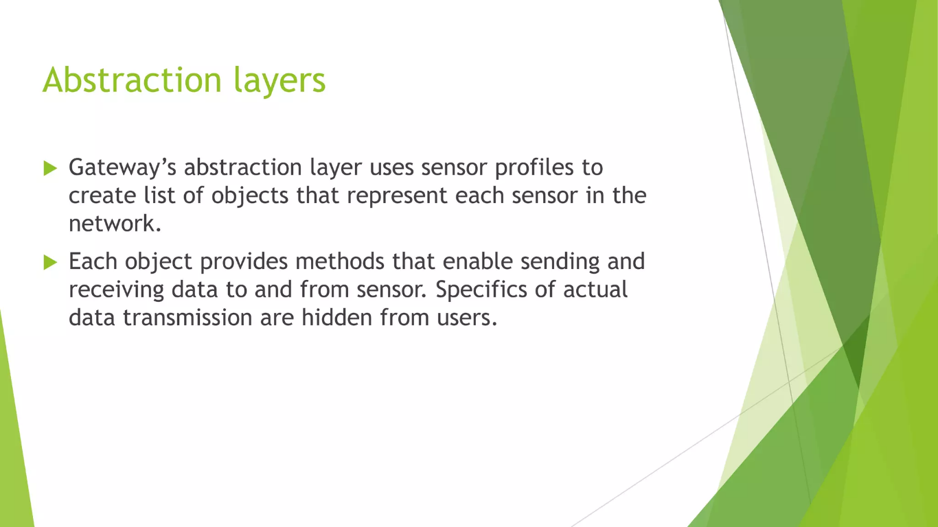

Slide 12
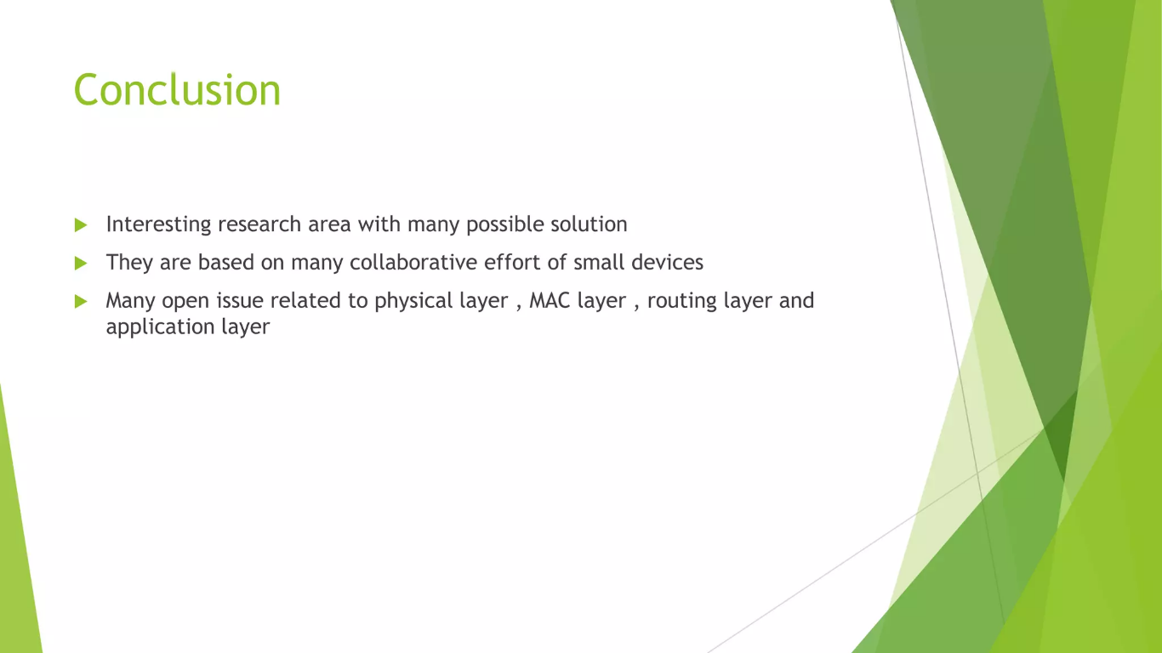

Slide 13


